Slide 1

Department
of
Mechanical Engineering
Estd.2003
Accredited by NBA and NAAC with ‘A’ Grade

Slide 2

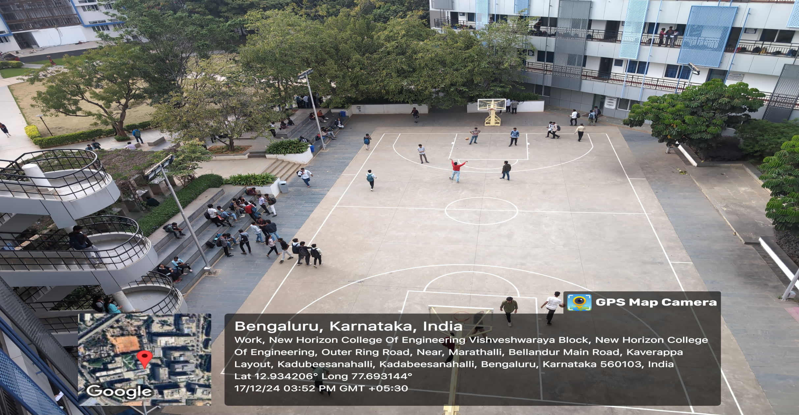
WELCOME TO THE DEPARTMENT OF MECHANICAL ENGINEERING

Slide 3

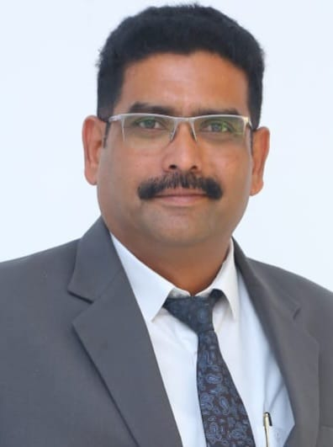
Head of department
Professor in Mechanical Engineering Department and holds an M. Tech and a Ph.D. in Engineering from Jawaharlal Nehru Technological University.
His academic journey is distinguished by active research engagement, guiding 3 Ph.D. scholars with publishing around 76 research articles. With more than 23 years of experience.
He is a mentor for UGC Paramersh and AICTE Margadarshan.
He involved in all types of accreditations works i.e. NBA, NAAC and Autonomous works.
He worked as BI In charge for MSME Innovative Scheme.
He got funding and completed one Projects which is funded by SERB, SEED Grant as a PI.
He authored more than 06 SCI, Scopus Papers, Conference papers and authored 12 Books published by prominent publishing houses.
He is a life member of various professional bodies like Indian Society of Technical Education (ISTE), Society of Automotive Engineers (SAE), Indian Welding society (IWS).
Dr. D. V. Sreekanth
M. Tech, Ph.D.

Slide 4
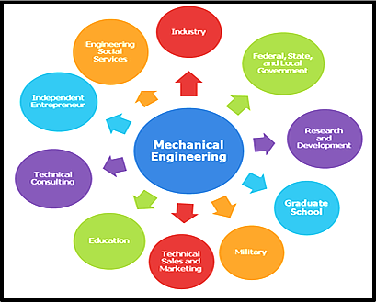
Programs offered
B.E – Mechanical Engineering
Ph.D in Mechanical Engineering Science

Slide 5
Vision and mission of the department
Vision
To create competent mechanical engineers capable of working in diversified disciplines for transformative impact on societal progressive development in the field of mechanical engineering through creative research and lifelong learning.
Mission
To impart excellent education by providing the state of art research facilities in the field of mechanical engineering.
To develop alliances with industries and other organizations for excellence in teaching learning process, research and consultancy projects.
To enhance the knowledge of students in intellectual, entrepreneurial and ethical challenges through active participation by critical thinking.

Slide 6
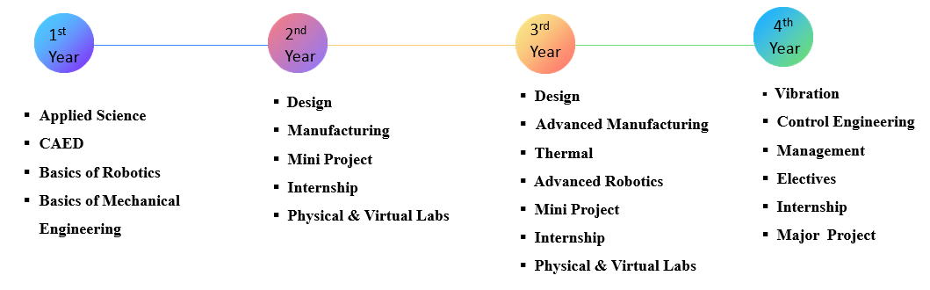
Program structure
Highlights:
Curriculum is designed as per National Education Policy
Centre of Excellence is driven by Industrial Curriculum
Digital labs – simulation & virtual labs
Internship, mini projects & major projects

Slide 7
STRENGTHS OF THE DEPARTMENT
ICT-Enabled Classrooms
Classrooms are equipped with Smart Display Boards, Overhead Projectors, and Book Projectors, ensuring an engaging and modern learning experience.
Qualified and Motivated Faculty
Faculty members, hailing from reputed institutions and universities, are adept at adopting new technologies and guiding students in innovative projects.
Awards and Recognition
Secure the highest number of student project funds annually from the Karnataka Council for Science and Technology (KSCST) for final-year projects.
Industry Collaborations (MoUs)
With over 5 active Memorandums of Understanding (MoUs), we provide students with enriched learning opportunities and industry exposure.
Sl.No. | Particulars | Numbers
1 | Total Book Publications | 35
2 | Total Fund available for the research work | 1 crore+
3 | Total Patents filed | 98
4 | Research Publications | 150+ Research articles

Slide 8
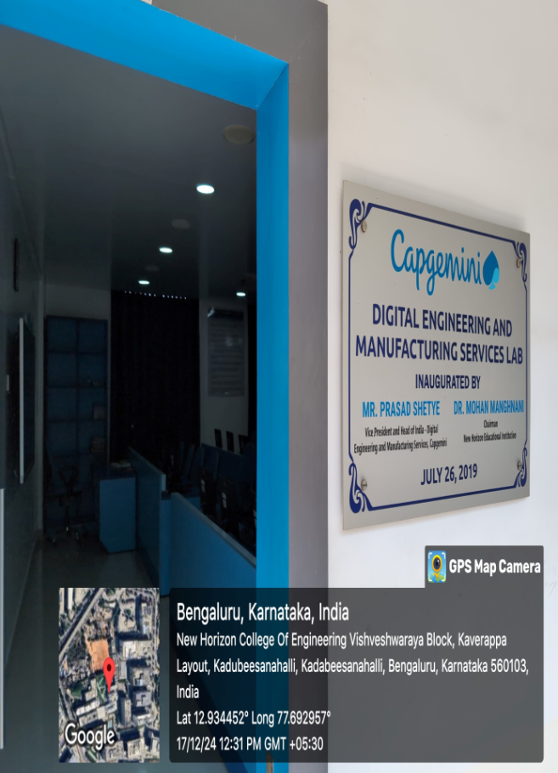
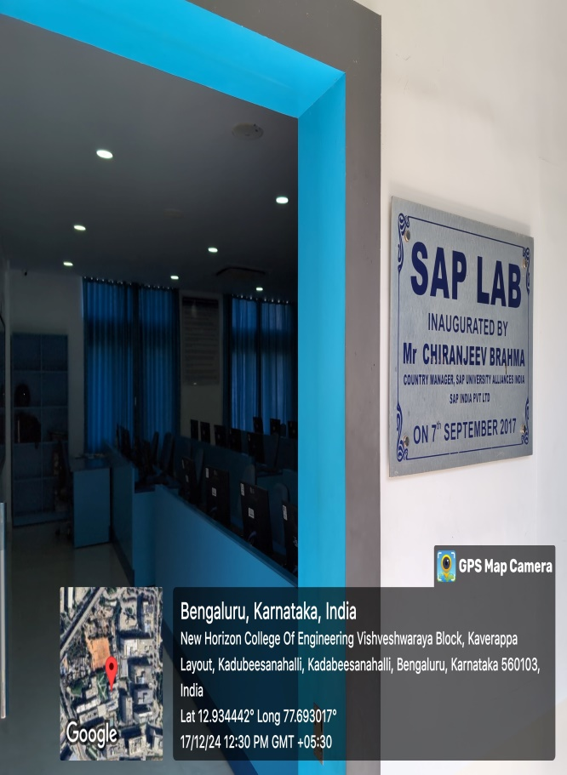
CENTRE OF EXCELLENCE (COE):
The Department of Mechanical Engineering has established five Centres of Excellence (CoE) to provide students with advanced training in cutting-edge engineering technologies.
These centres aim to bridge the technological gap between academia and industry, ensuring students are industry-ready and equipped with the latest skills.
1. Sap Next Gen Lab Centre of Excellence
2. Capgemini Centre of Excellence
3. Industry 4.O Centre of Excellence
4. Non-Conventional Energy Resources Centre of Excellence
5. Centre of Excellence for Bio-Mechanical Engineering Sciences.

Slide 9
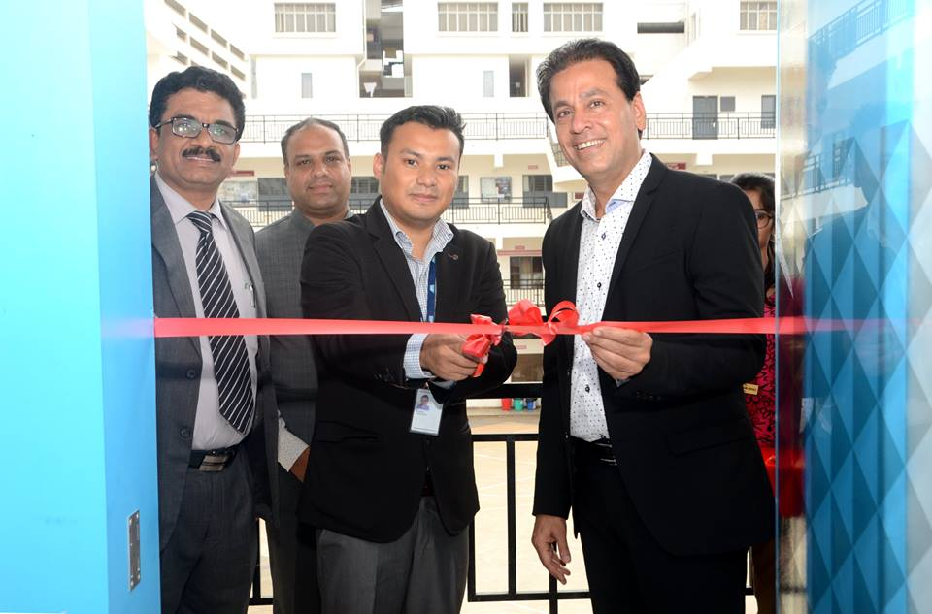
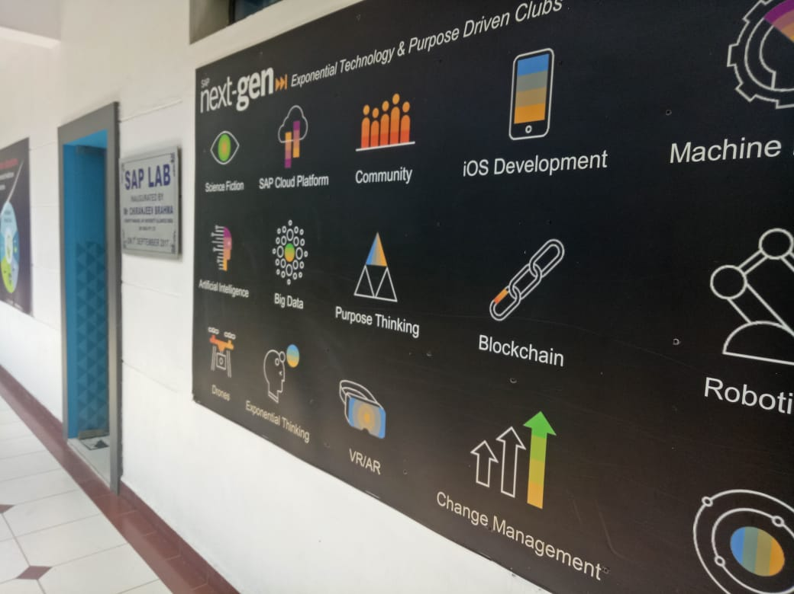

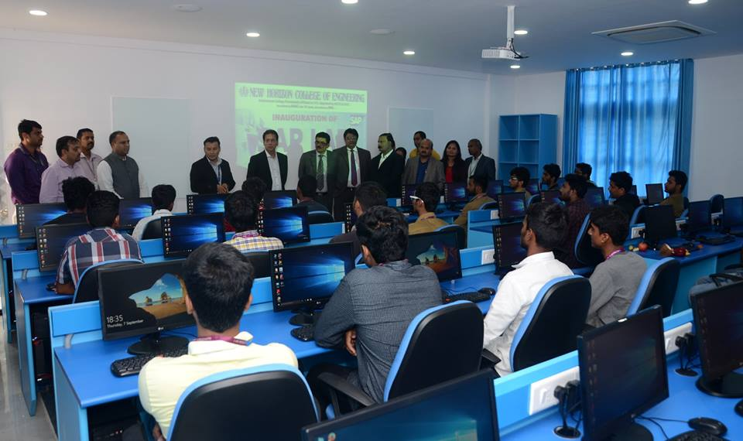
INDUSTRY SUPPORTED LAB
SAP LAB inaugurated by Mr. Chiranjeev Brahma, Country Manager, SAP University Alliances India &
our Honorable Chairman Dr. Mohan Manghnani on 7th September 2017

Slide 10
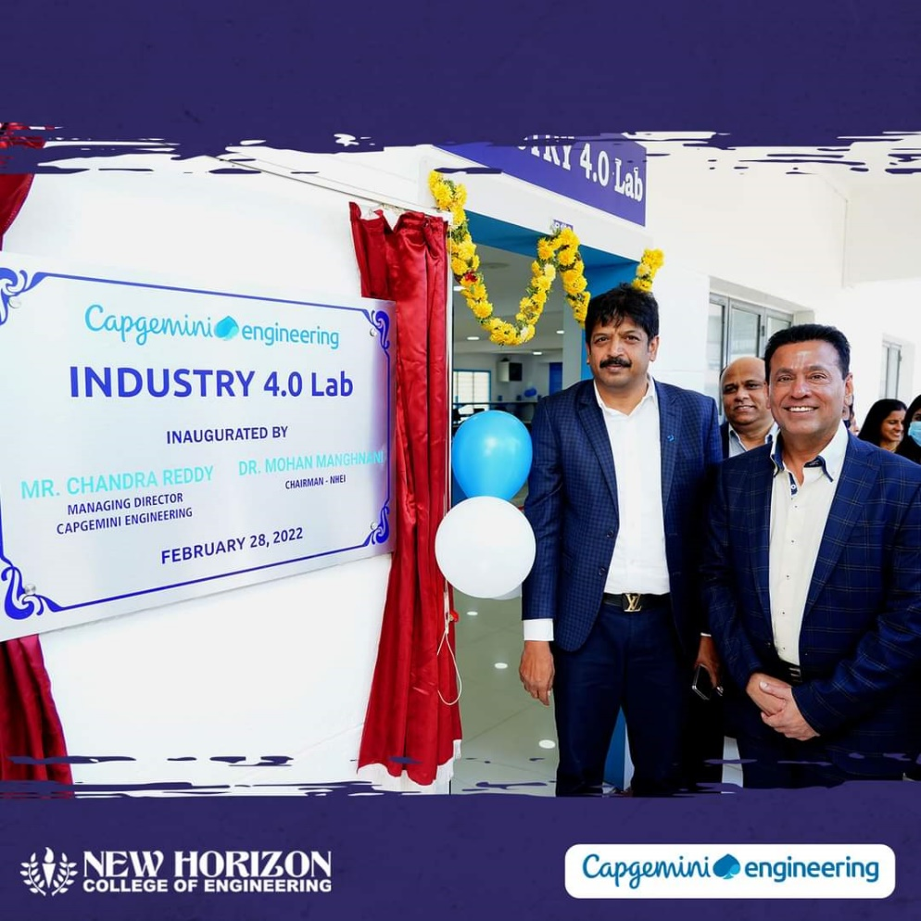
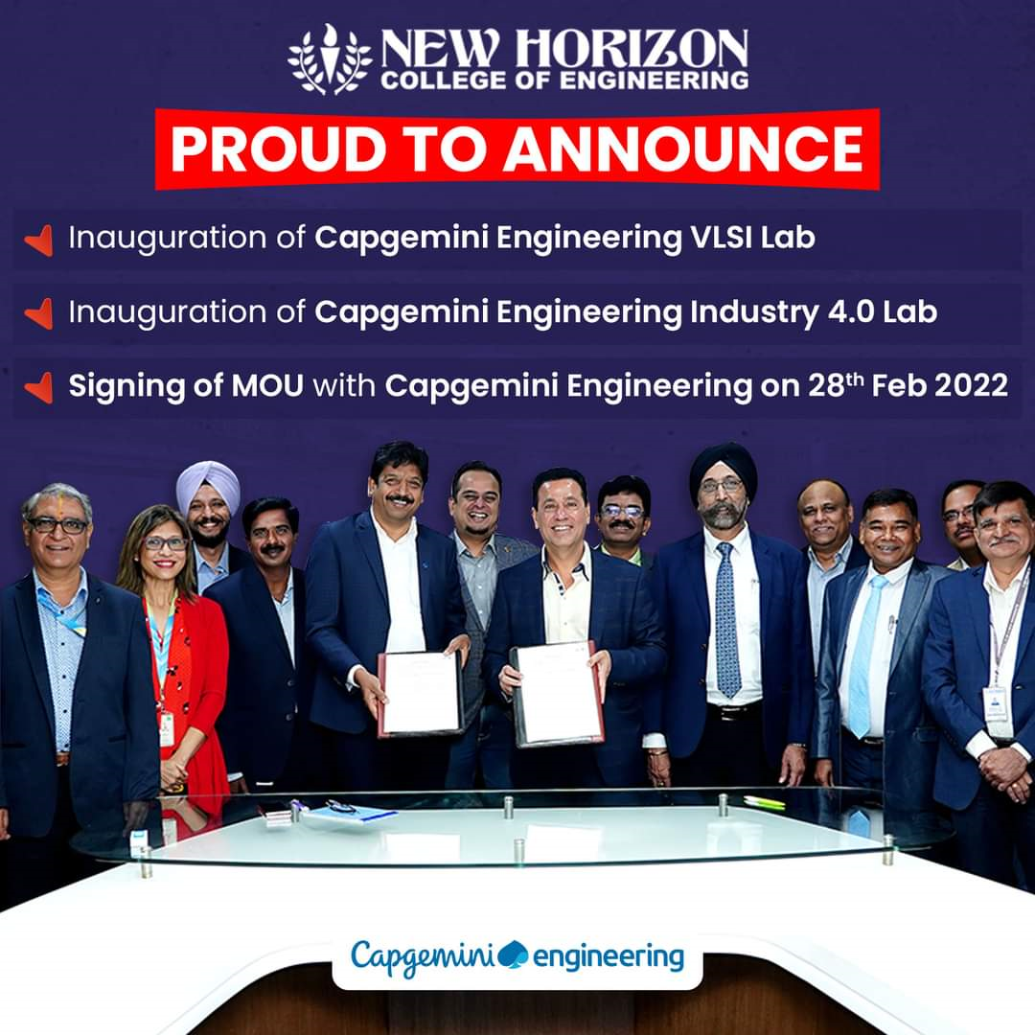
INDUSTRY 4.O CENTRE OF EXCELLENCE
Capgemini Engineering, a global leader in providing premium engineering solutions, has launched Industry 4.O Centre of Excellence at New Horizon College of Engineering (NHCE), Bengaluru.

Slide 11
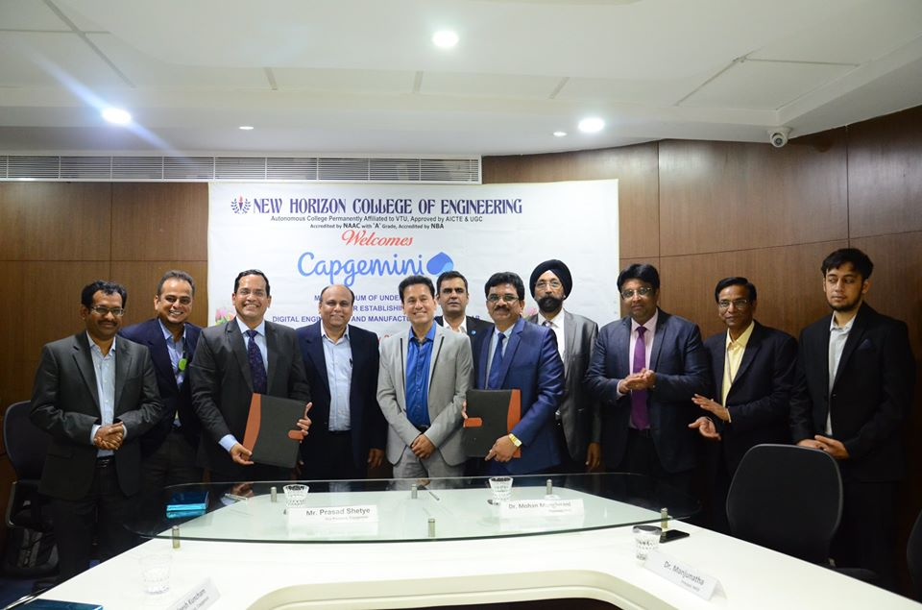
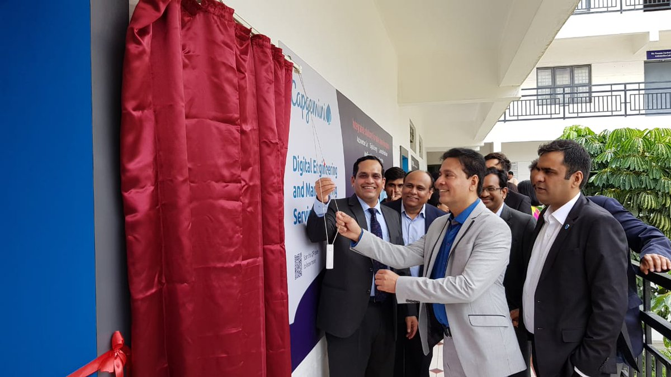
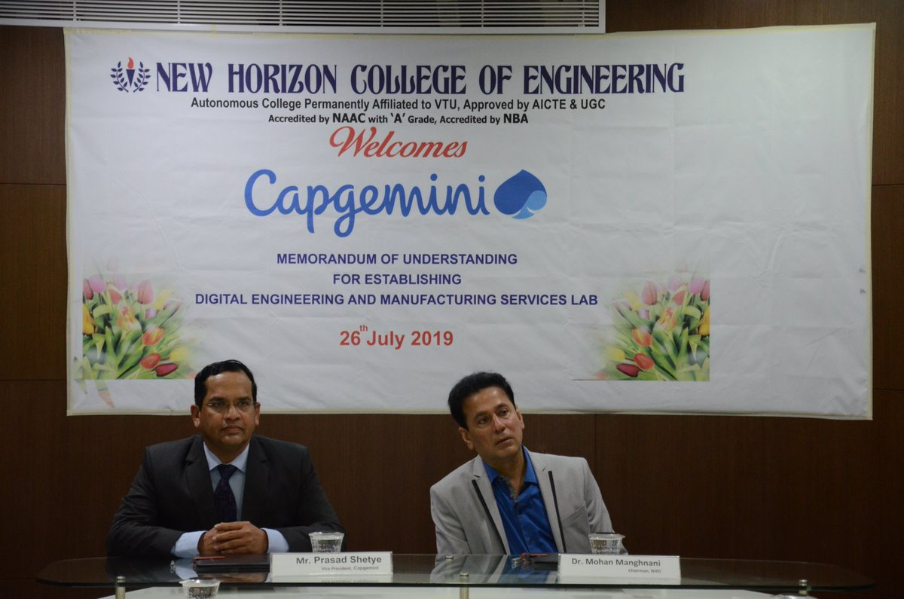
Centre of Excellence for Digital engineering and manufacturing services

Slide 12
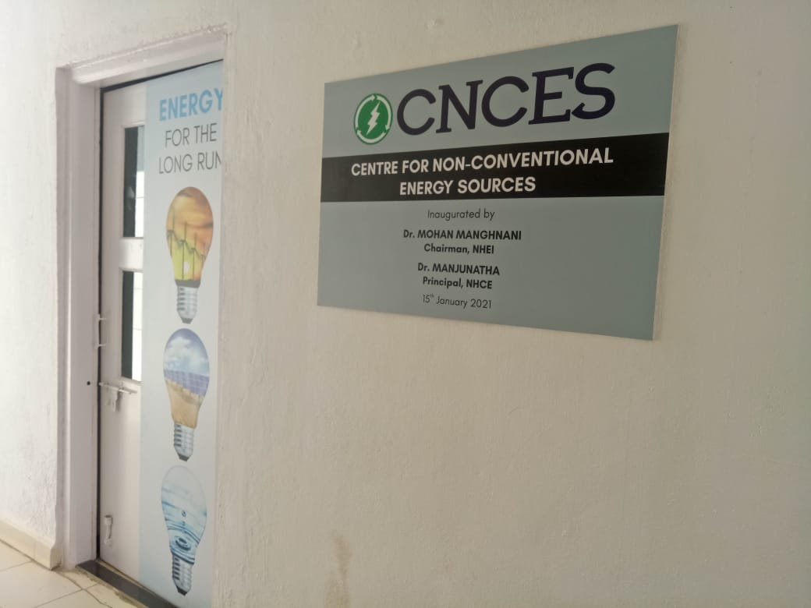
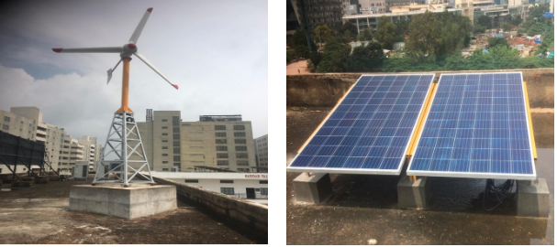
Centre of Excellence for Non-Conventional Energy Resource
Inauguration of Centre of Excellence for Non-Conventional Energy Resource

Slide 13
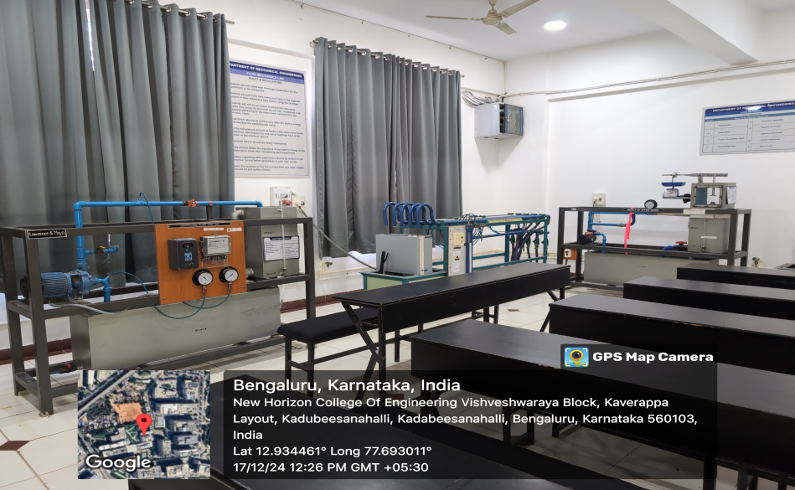
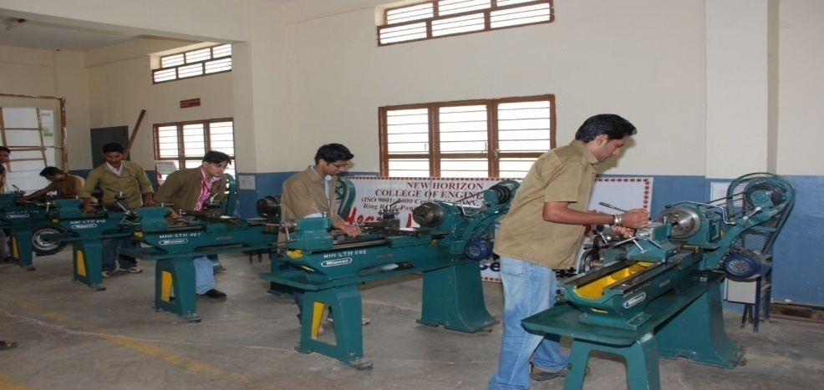
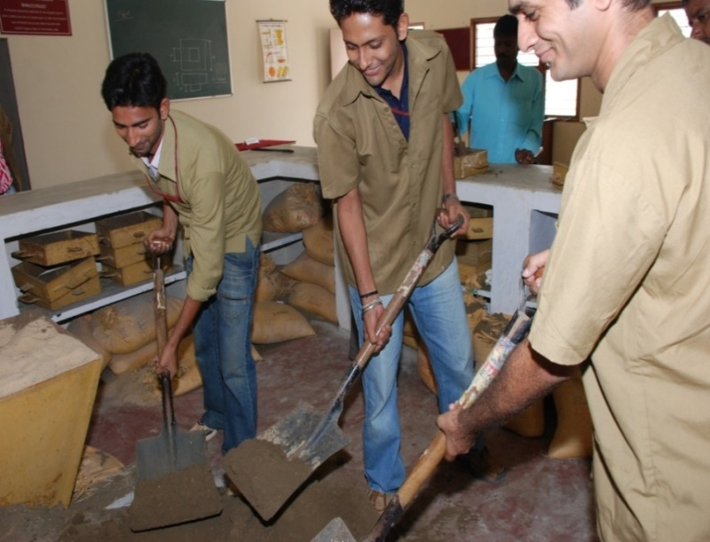
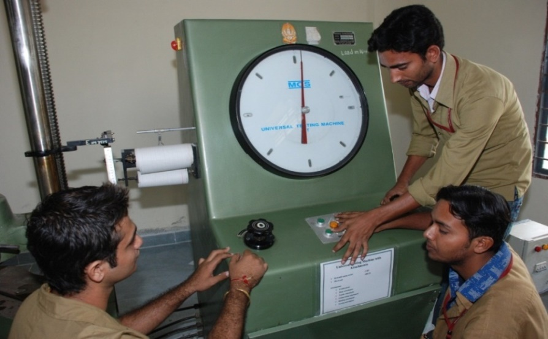
DEPARTMENT LABS
Fluid Mechanics Lab
Machine Shop
Foundry Lab
Material Testing Lab

Slide 14
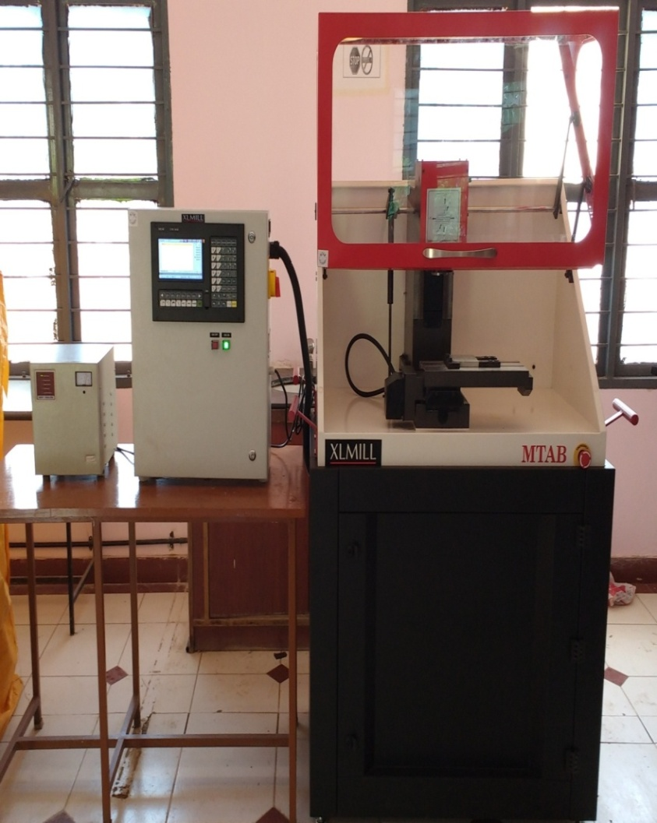
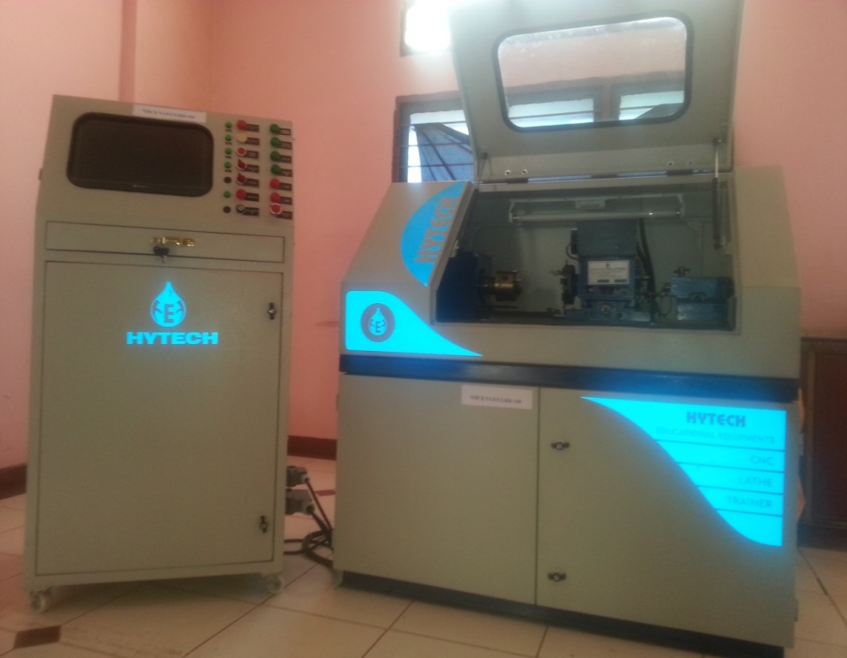
LABORATORY EQUIPMENTS
CNC Milling Machine
CNC Lathe Machine

Slide 15

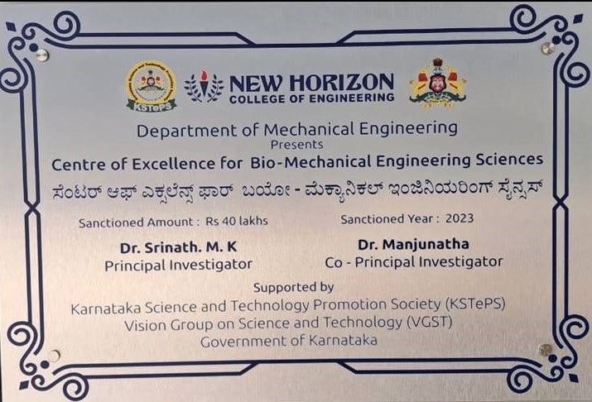
GRANTS RECEIVED
Received fund of Rupees Thirty Lakhs from Vision Group – for Science & Technology Govt. of Karnataka for executing a project on Recycling of cutting fluids
Received Fund of Rupees Forty lakhs from Vision Group – for Science & Technology Govt. of Karnataka for setting up the Centre of Excellence for Bio-Mechanical Engineering Sciences.

Slide 16

GRANTS RECEIVED
Received grant of Rupees Thirteen lakhs forty seven thousand and fifty nine from AICTE for conducting projects under Research Promotion scheme for the financial year 2017-18
Received grant of Rupees Seven lakhs from AICTE under Faculty Development program (Advanced Materials and Application )for the financial year 2019-20
Received grant of Rupees Three Lakhs Fifty Three Thousand from AICTE for Short Term Training Program for the financial year 2020-2021.
Received grant of Rupees Ninety Three Thousand from AICTE online ATAL FDP for the financial year 2021-2022
Received grant of Rupees One Lakh from AICTE online ATAL FDP for the financial year 2024-2025

Slide 17
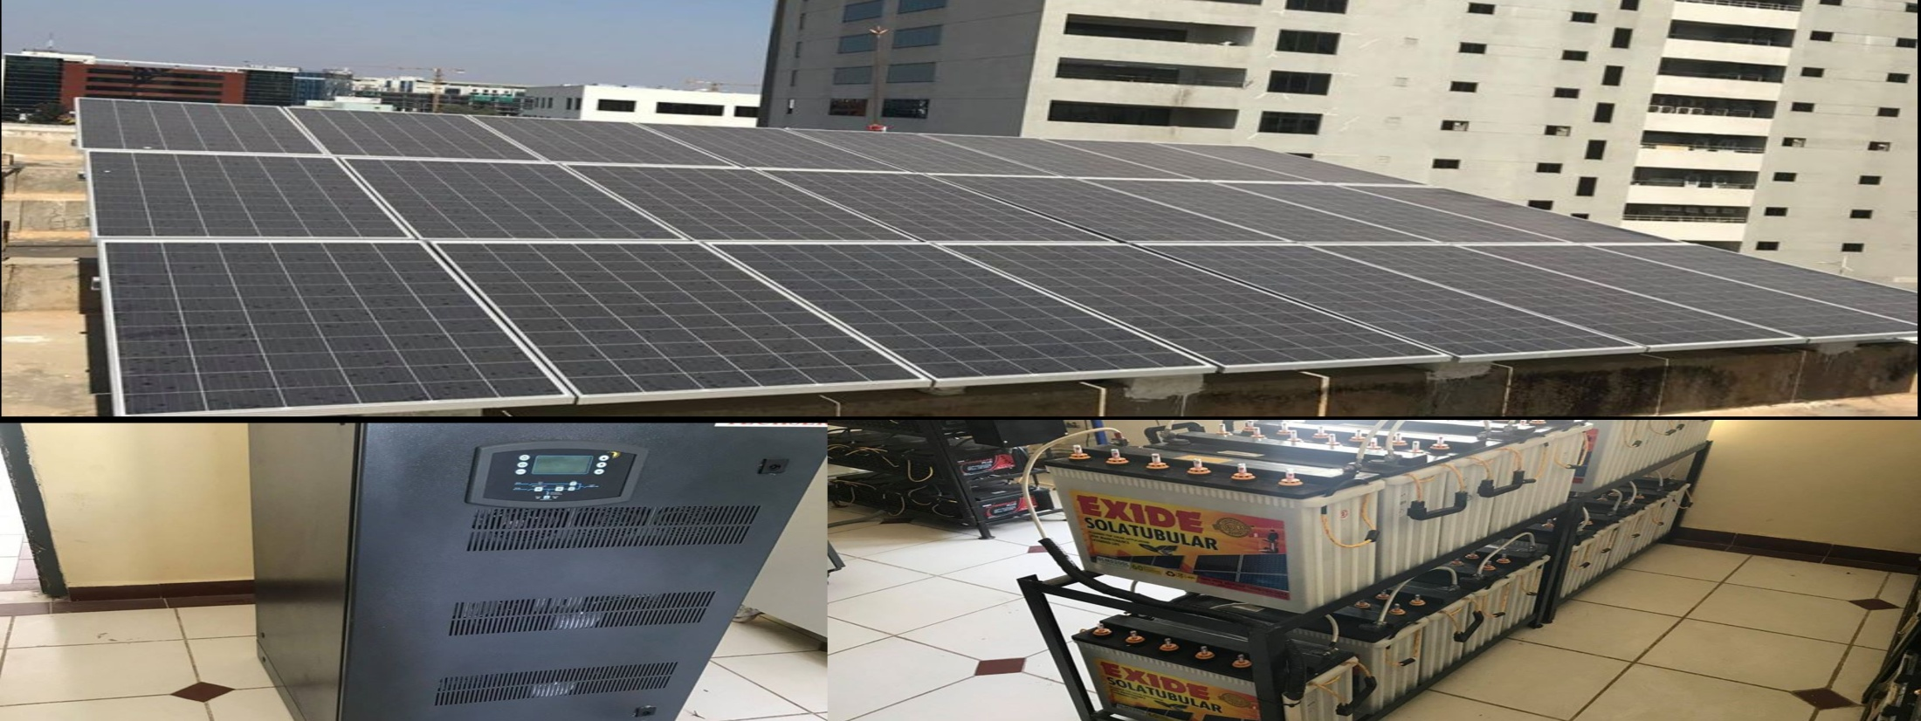
SOLAR PV SYSTEM Project
The Department of Mechanical Engineering has successfully installed a 30 kW solar photovoltaic (PV) system at the Sardar Vallabhbhai Patel Block.
This solar power system is now providing electricity to all the classrooms and laboratories within the block, making it a sustainable and eco-friendly energy solution.
This initiative aligns with the department's commitment to advancing renewable energy technologies and promoting sustainable practices in the academic and research environment.
30KW SOLAR POWER SYSTEM

Slide 18



MoU’s
The Department of Mechanical Engineering has established strong collaborations with leading industries to enhance Industry Institute interactions, providing students with valuable exposure to cutting-edge technologies and real-world applications.
SAP Labs: Mechanical Engineering students will engage in live projects and case studies, providing hands-on experience in solving real-world problems.
Industry 4.0: A Center of Excellence (CoE) will be developed focusing on Industry 4.0 technologies. Students will gain experience working with the latest advancements in Industrial Internet of Things (IIoT) and Cloud Computing.
AutoLiv India Pvt. Ltd: This partnership will introduce students to the latest safety technologies used in Aerospace Engineering, enhancing their knowledge and expertise in this critical field.
Capgemini DEMS Lab: Aimed at making students industry-ready, this collaboration will offer insights into the latest technological trends and learning methods, with guidance from industry and academia experts in the field of Product Lifecycle Management (PLM).

Slide 19
FUNDED PROJECTS
AICTE has sanctioned Rs. 13.26 lakhs under research proposal scheme for project titled “Multipurpose Compact Solar Fruit Dryer”
TCA, CSPD- Serbia, UNISEC India , ITCA, TSC Pvt Ltd has sanctioned Rs.29.5 lakhs towards “Design And Development Of Unitysat, Cubesat, single card satellite bus” from past 3 years
KSCST has granted Rs.4 lakhs towards research projects from past 4 years

Slide 20
CONSULTANCY PROJECTS
Pulse sports Pvt. Ltd has sponsored Rs.3.6 lakhs towards Productivity studies and Enhancement
Infant Travels has sponsored Rs.1 lakh towards Integrated maintenance model for a duration of 1 year
Globe Express Travels has sponsored Rs.50,000 towards Customer survey and analysis
ICON, Kolkata has sponsored Rs.10,000 towards HVAC design

Slide 21
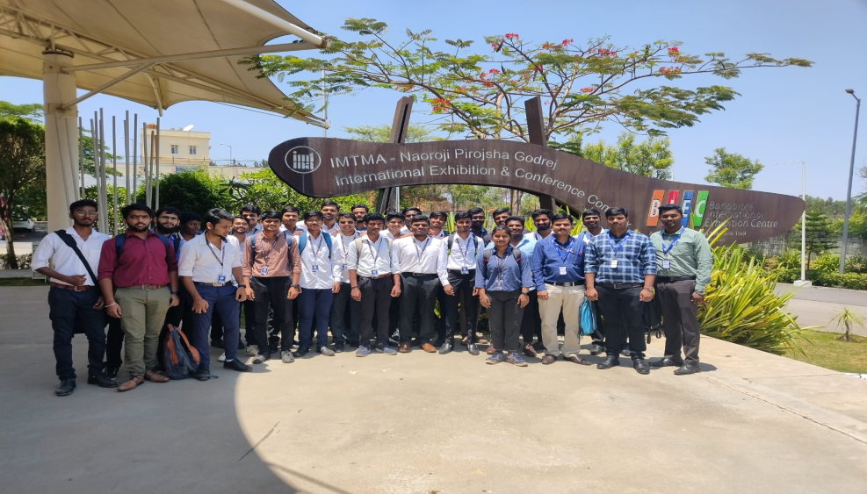
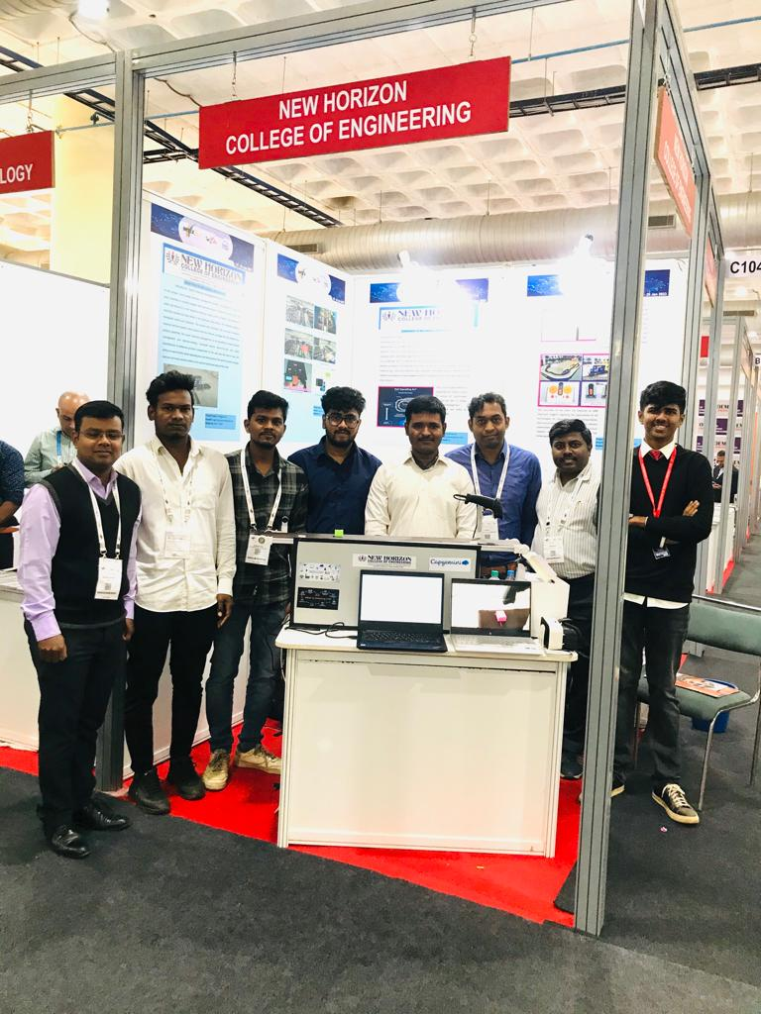
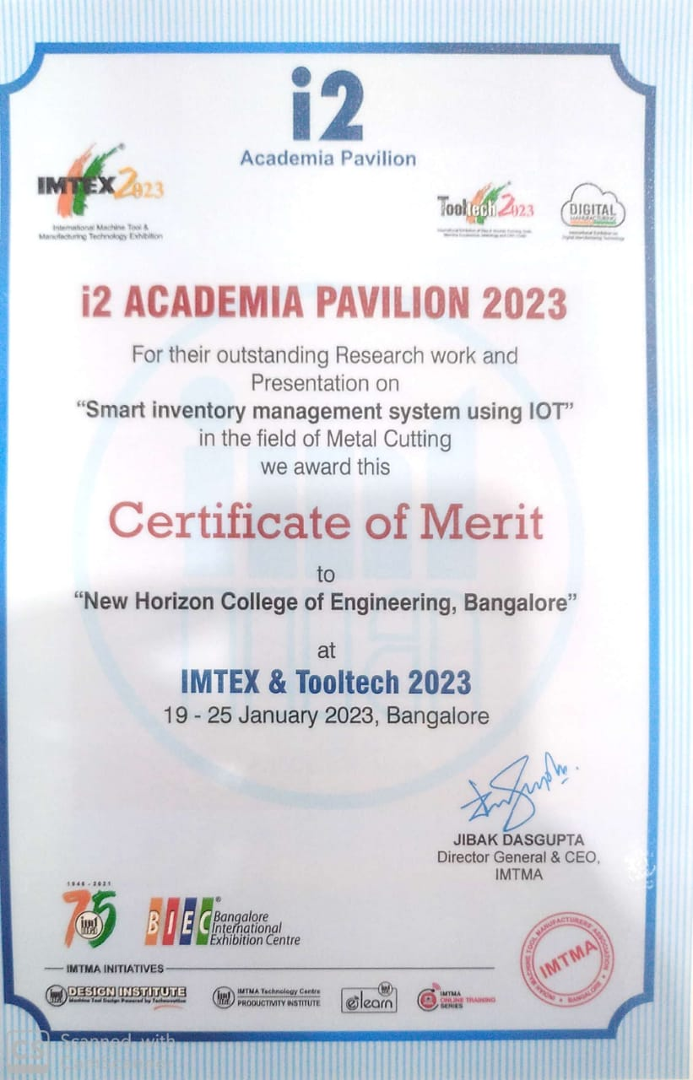
Departmental Activities: International level Exhibition
IMTEX Forming 2024: Exhibited a model on “Smart inventory management system using IOT” in the field of metal cutting.
Awarded: For outstanding research work and presentation, held in BIEC on 19-25 Jan 2023

Slide 22
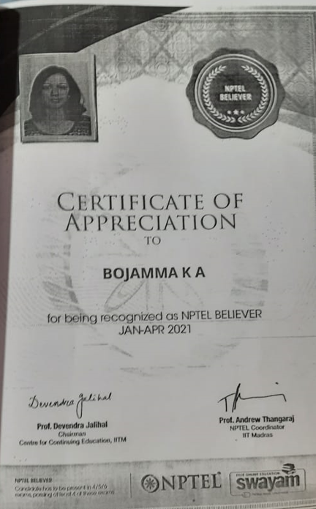
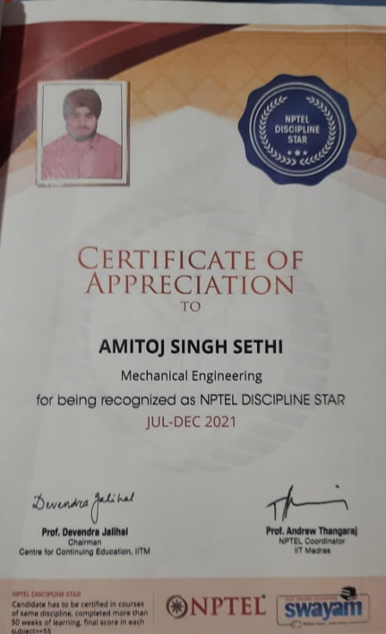
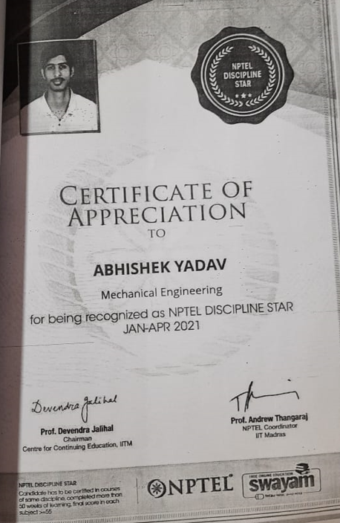
Departmental Activities: Student Achievement National Level
NPTEL: 18 Credits Completion: BE Honors
Si.no | USN | Student Name
1 | 1NH18ME017 | Amitoj Singh
2 | 1NH18ME026 | Bojamma K A
3 | 1NH18ME703 | Abhishek Yadav
4 | 1NH19ME051 | Jemima kyra jonathan
5 | 1NH19ME078 | Neil Dhiren Saldanha
6 | 1NH20ME107 | Suraj Ram

Slide 23
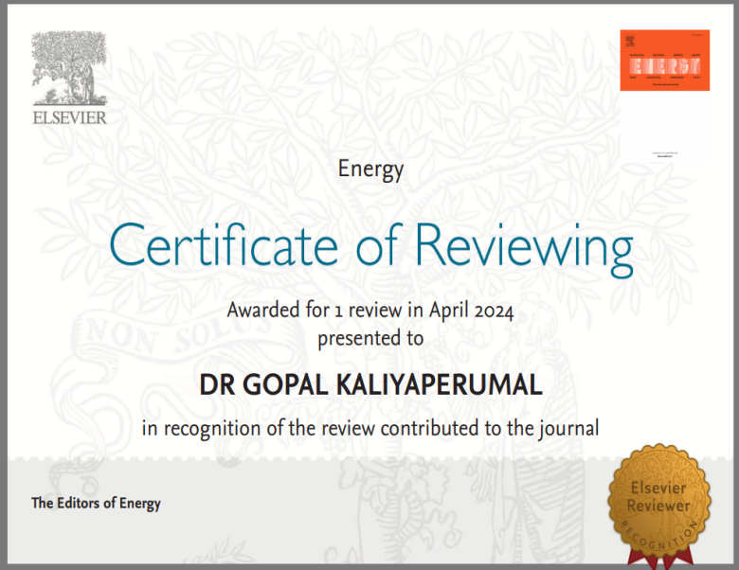
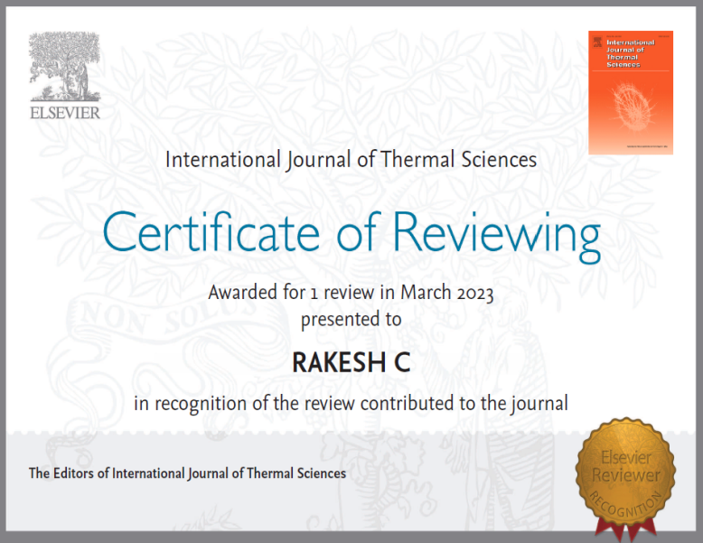
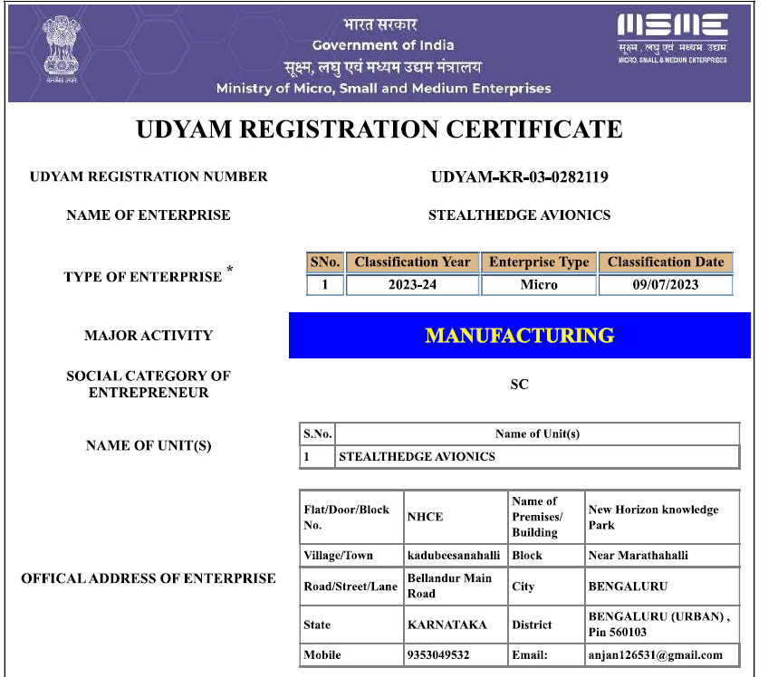
Departmental Activities: Research & Development
From the Department of Mechanical Engineering the total number of Scopus-indexed articles/conferences published is 100+, Accepted 20, under review is 25, submitted is 50+, Citations 500+ |  | 11 Patents shortlisted for the Kapila scheme (financial assistance for patent publications) Faculty are reviewers in reputed Scopus-indexed Journals. |  | Projects converted to startups: Students of the Mechanical Engineering Department, have registered the company Stealth Avionics under MSME scheme
Dept. of ME, NHCE
23

Slide 24
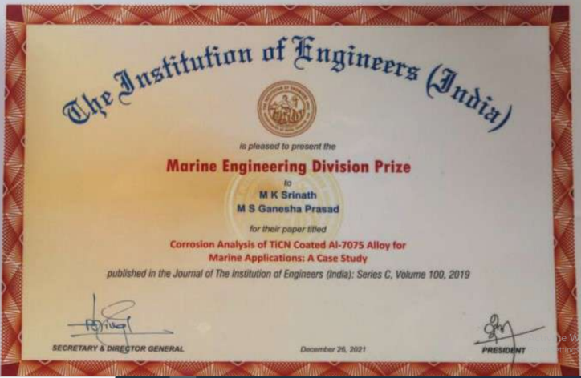
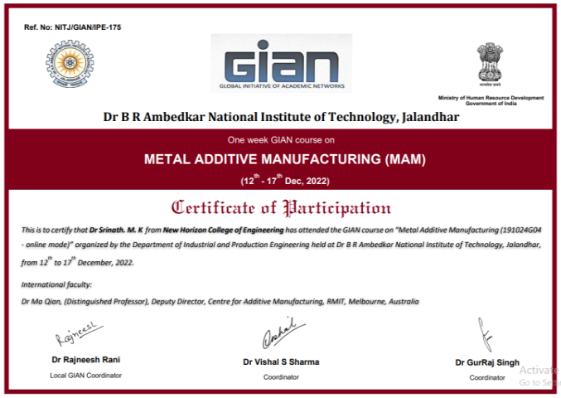
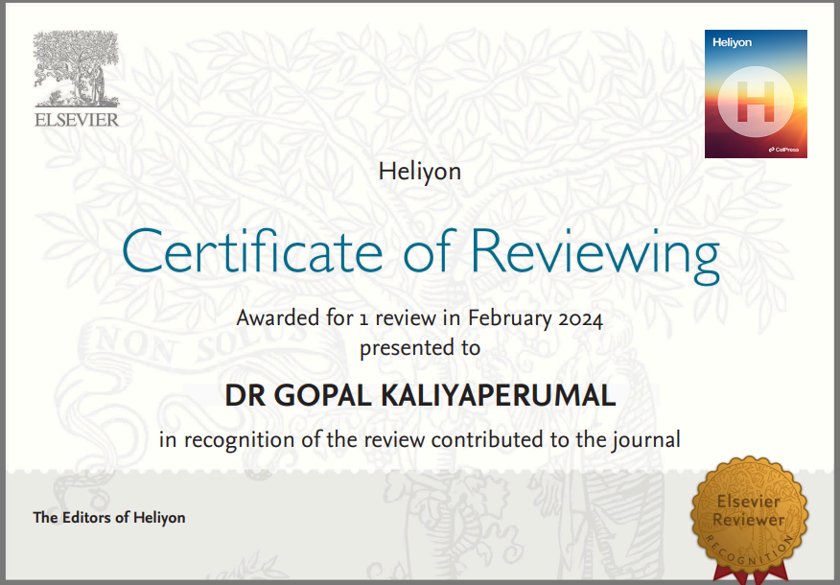
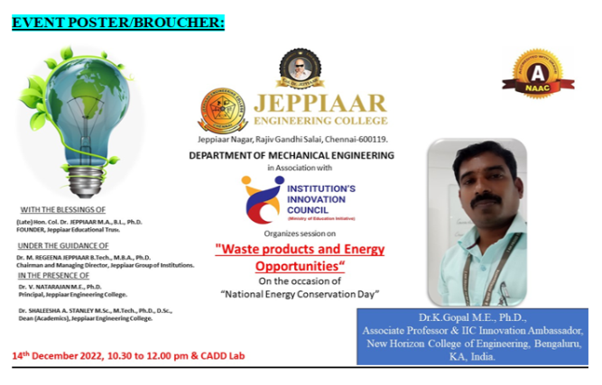
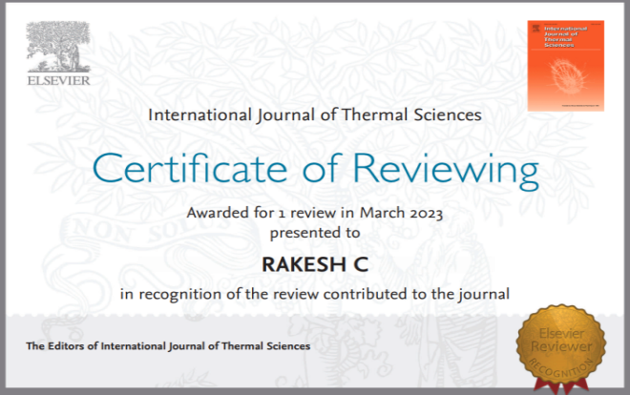
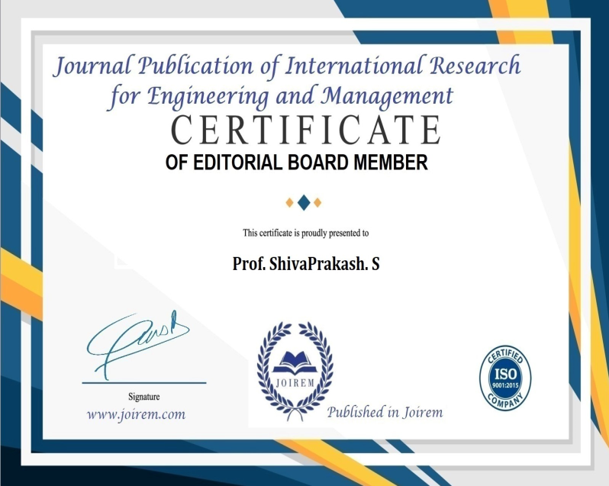
FACULTY EXPERTIZE & ACHIEVEMENTS

Slide 25
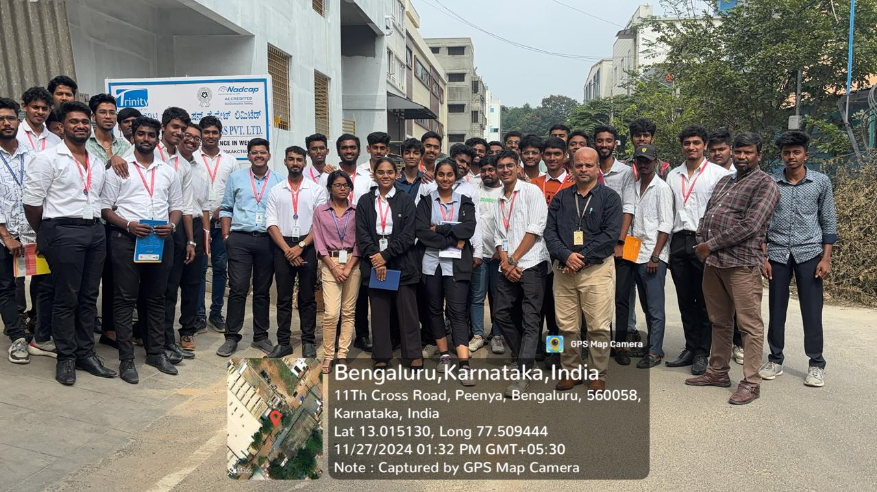
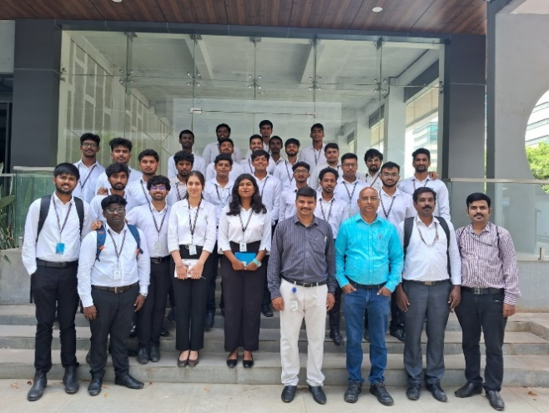
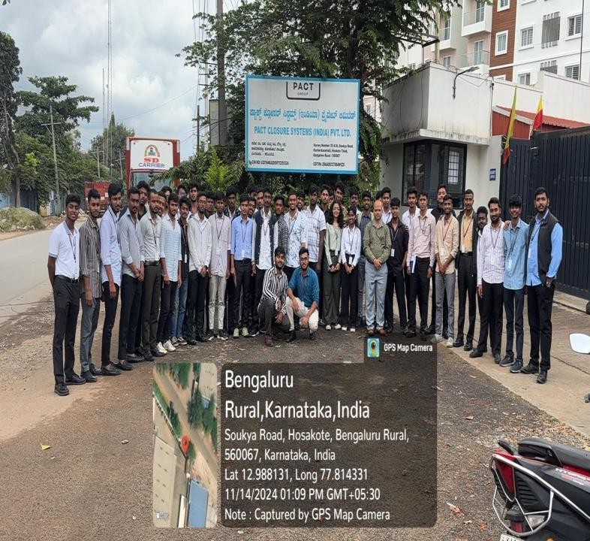
INDUSTRY VISITS CONDUCTED
Industrial visit to Trinity NDT Weld Solutions Pvt Ltd,Bangalore-2024
Industrial Visit to Edizi Tools Pvt Ltd -2024
Industrial Visit to Pact Closure Systems India Pvt Ltd - 2024

Slide 26





Value Added Programs – BEYOND SYLLABUS
Students are trained to undergo additional programmes along with regular academic subjects to help in placements.
The list of value added programs
CAD / CAM certification programme through CATIA
CNC Simulator certification programme through DELCAM Software
Analysis Training through CFX for CFD
Analysis Training through ANSYS
Training through ANDROID
Global Tour
Certification course in Management & Leadership
PCB design .

Slide 27
Departmental Placements
Placements: 45 students are been placed out of 60 eligible students, still the process is ongoing. The highest package is Rs. 27 LPA from International Placements & Rs. 10 LPA from National Placements.
.
Companies Visited
20+
Highest Salary Package
Rs. 27 LPA
Average Salary Package
Rs. 4.75 LPA

Slide 28








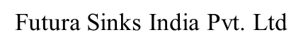











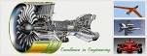




PLACEMENTS: Our Recruiters
Indian Navy.
Volvo.
Godrej & Boyce.
ACE Designers.
Creative Engineers.
Goodrich Aerospace.
L & T IES.
Tech Mahindra.
NTT Data
Century Link.
Amazon.
TWB Pvt. Ltd.
SIKA Interplant System Ltd.
Infinite computer solutions.
Light Mass Solutions.
SPERIDIAN TECHNOLOGIES
P3 Voith Aerospace.
Seine Product design Pvt. Ltd.
Rinac India Ltd.
Skyfi Labs.Piaggio Industries.
HP.
Futura Sinks India Pvt. Ltd.
Infotech Enterprises.
Intuitech India.
Racks and Rollers.
Walvoil Fluid power India Pvt. Ltd.
Wipro.
IBM.
TCS.
QuEST Global
Continental
MU SIGMA
IDEAS 91
AASHI GLASS
APEX AUTO
AMAR RAJA

Slide 29
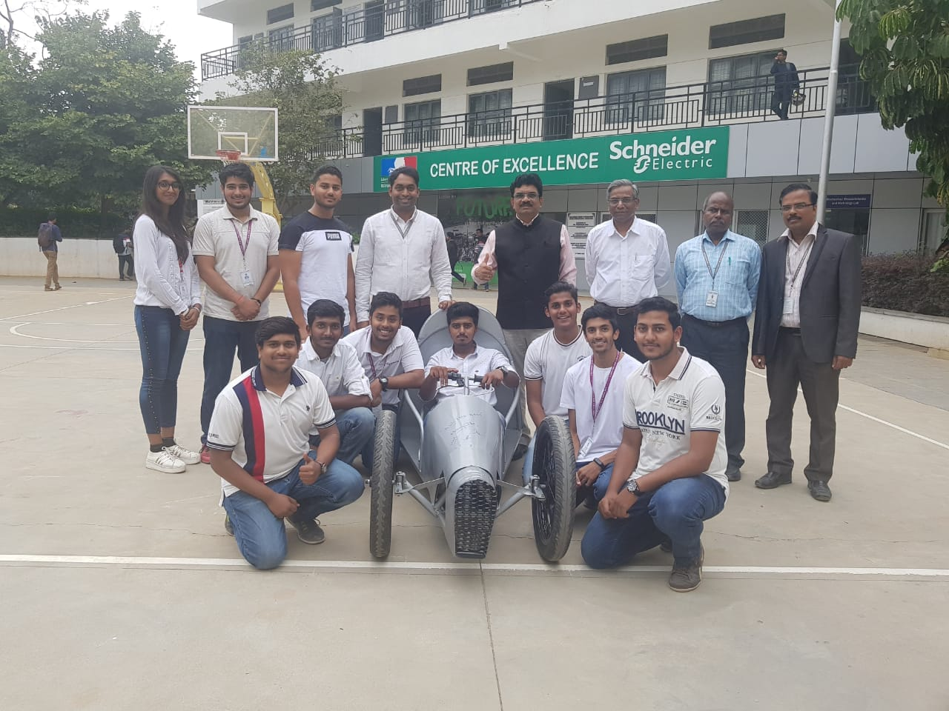
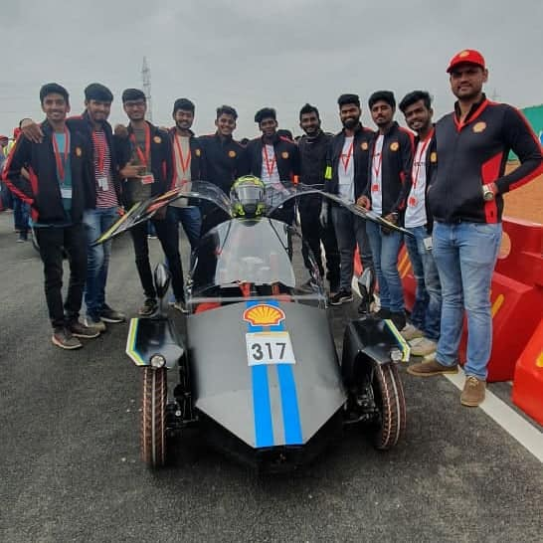
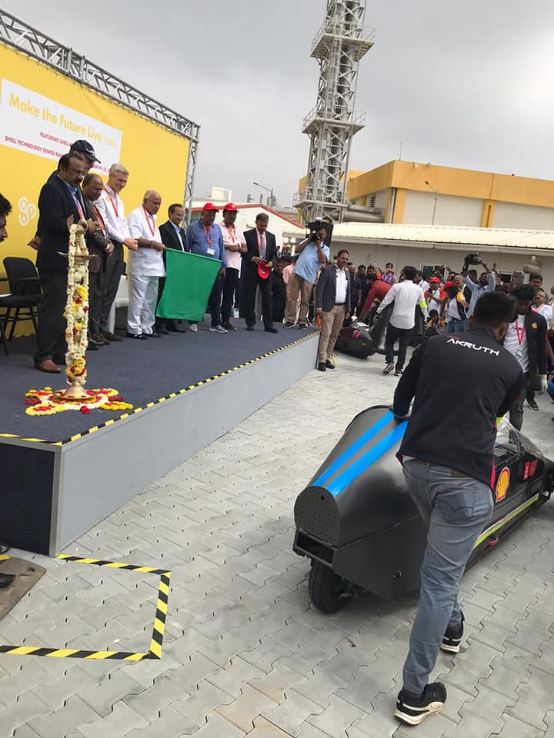
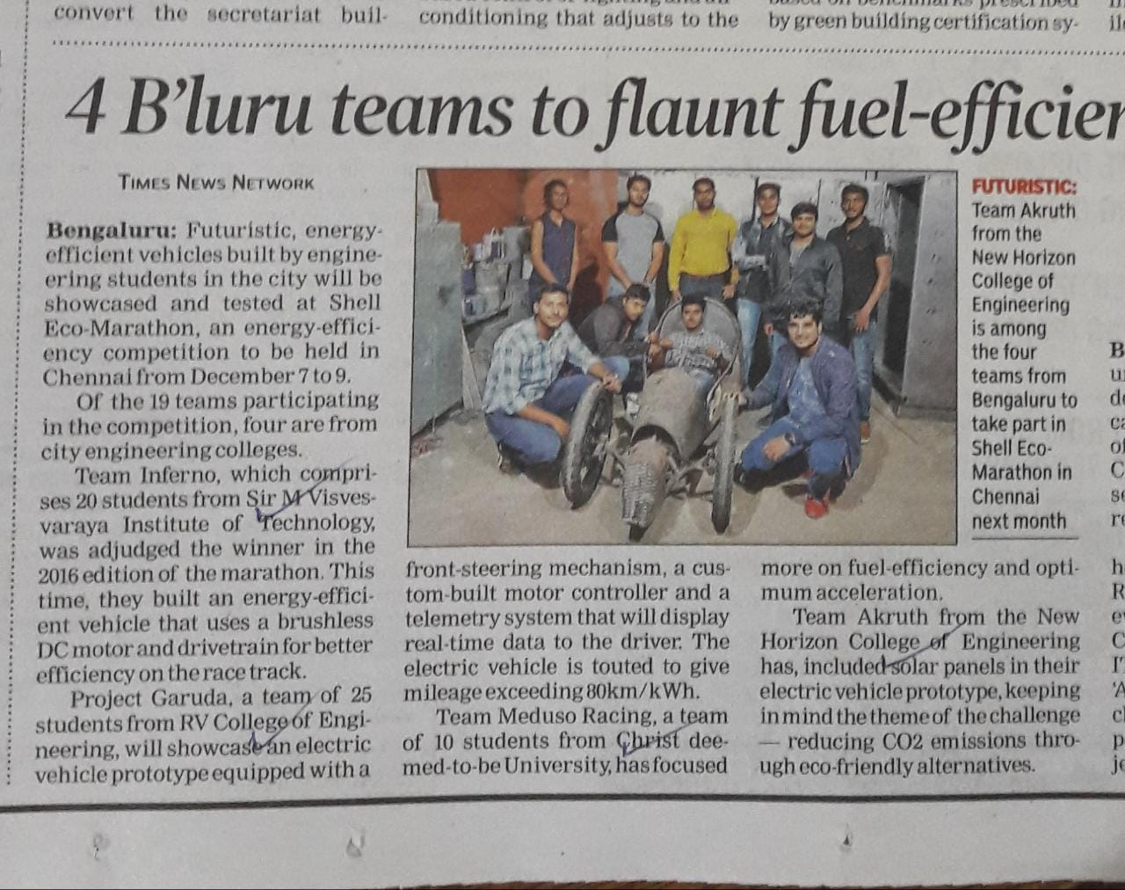
Student PROJECT FUNDED BY SHELL
The team-AKRUTH successfully completed the track event at national circuit in shell eco marathon event
Team NHCE-AKRUTH is the only team qualified from South India from this event
The team made an *event record of driver exit time 0.72 seconds* beating earlier record of 1.2 seconds
Team NHCE-AKRUTH is qualified for international event scheduled on June July 2020 at Malaysia

Slide 30
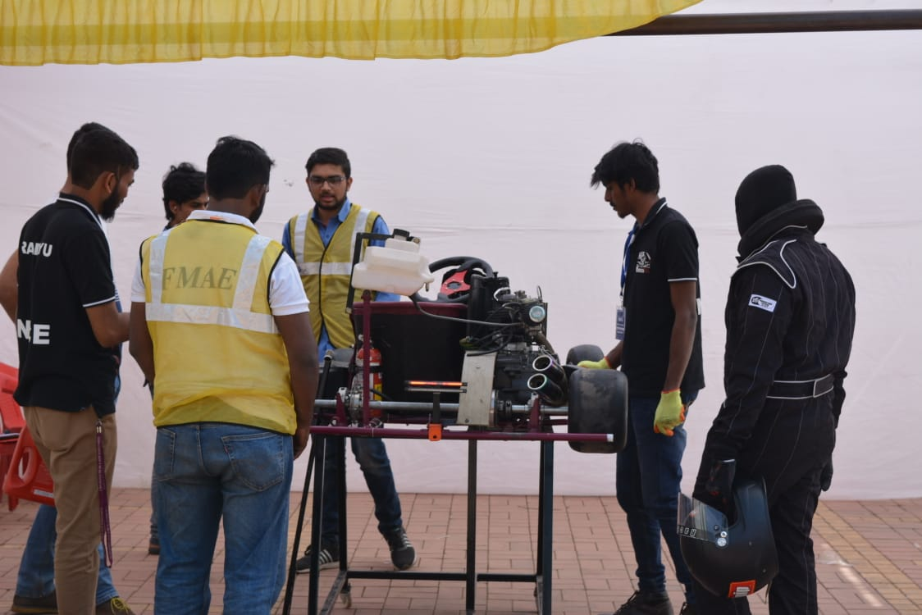
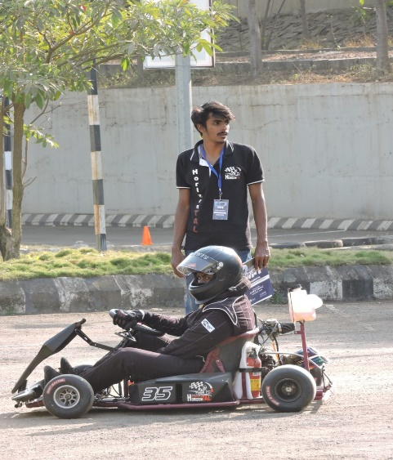
Students External Participations: Go Kart Event
The team cleared all technical inspection in a single shot and got a track access. Only team cleared all rounds with valid result from South India.
In Photo: Go kart Team ‘HORIZONTAL’ Participated in FKDC Pune

Slide 31








GUEST LECTURE FROM INDUSTRY

Slide 32







Departmental Activities:
Faculty Development programs /trainings/expert lecture
Departmental Activities:
Faculty Development programs /trainings/expert lecture
32
Dept. of ME, NHCE
32
Dept. of ME, NHCE
32
Dept. of ME, NHCE

Slide 33









Departmental Activities: Extracurricular Activities, NCC, NSS
Dept. of ME, NHCE
33

Slide 34

STUDENT CLUB
Department of mechanical has a student club to engage students in experiences beyond classroom.
The activities foster involvement, promote leadership and instil life skills ensuring personal and professional development.
RoboHorizon Club – (RHC)

Slide 35

ALUMNI Testimonials
I am truly grateful to New Horizon College of Engineering for the transformative experiences I had during my course of time . The guidance, support, and opportunities offered by the department and institution have played a crucial role in my success and shaped me.
NHCE’s commitment to academic excellence, alongside its focus on holistic growth, has allowed me to discover and realize my potential. It’s a place where innovation is fostered, and creativity is celebrated. The values of hard work, dedication, and perseverance are deeply embedded in its culture. The experiences I gained at NHCE have been invaluable, both in my career and personal life.
Looking back on my journey at this exceptional institution, I feel immense gratitude for everyone who has contributed to my growth. I am proud to be an alumni of NHCE, and I will forever cherish the memories, lessons, and friendships that have shaped my time there. Thank you, NHCE!
Mr. Melvin C
2024 Pass out
Analyst ,
Capgemini Technology Services India Limited,
Bengaluru

Slide 36




For more information please contact
Mobile: +080-66297777
E mail: admissions@newhorizonindia.edu
Website: www.newhorizonindia.edu
Follow us on:

